Slide 1
CM and ML (Phases)
Moayid ali

Slide 2
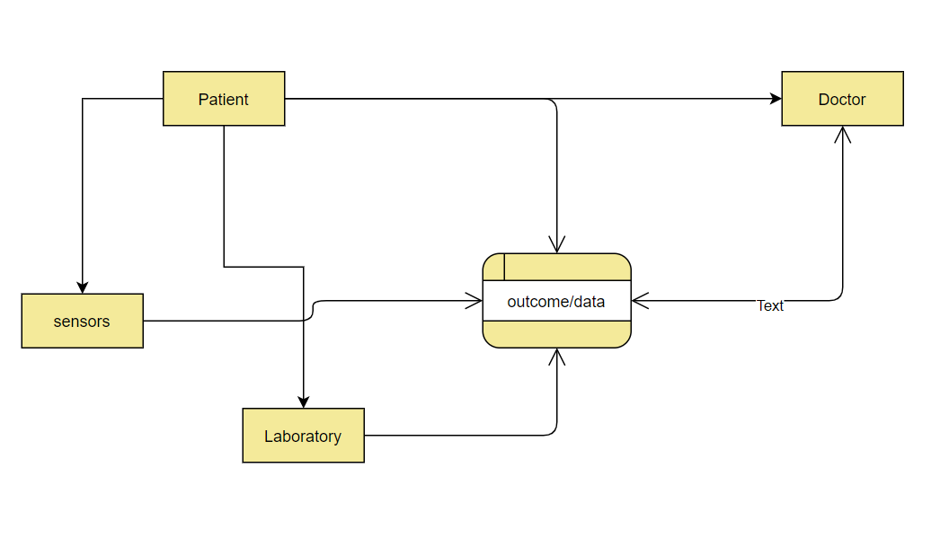
Business Understanding
Represent, abstract domain, Identify boundary objects
Notes:
A boundary object is defined as an artifact or a concept with enough structure to support activities within separate social worlds
A conceptual business model is a diagram that illustrates how an industry or business functions. It shows important elements in the business, and maps out how those elements relate to each other
The Business Understanding stage is crucial because it helps to clarify the goal of the customer.
once the business problem has been clearly stated, the data scientist can define the analytic approach to solve the problem.

Slide 3
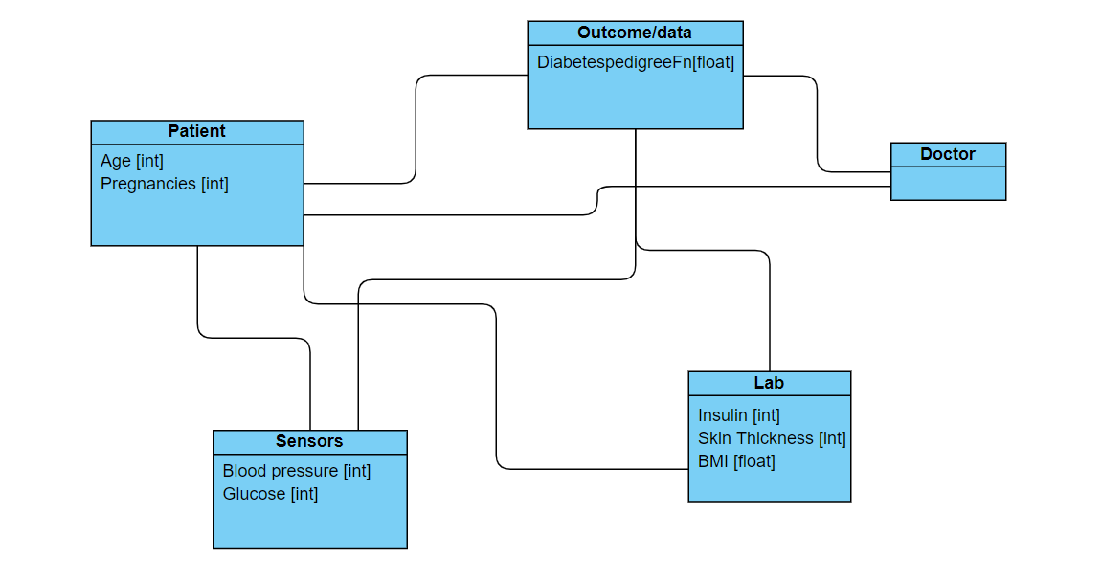
Data Understanding
Modeling Script, extending
Notes:
Modeling Scripts enables you to develop realistic view and improve the quality. of the Test results produced
The conceptual data model is a structured business view of the data required to support business processes, record business events, and track related performance measures. This model focuses on identifying the data used in the business but not its processing flow or physical characteristics.
Step 1: Gathering the data. ...
Step 2: Handling missing data. ...
Step 3: Taking your data further with feature extraction. ...
Step 4: Deciding which key factors are important. ...
Step 5: Splitting the data into training & testing sets.

Slide 4
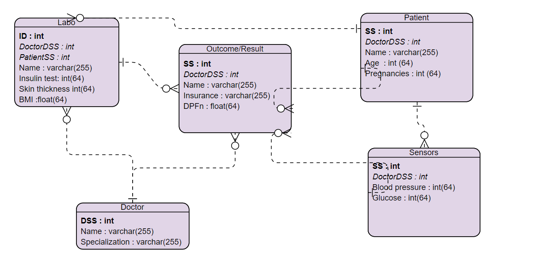
Data Preparation
Attribute selection, cleaning, transformation
Notes:
Data preparation (also referred to as “data preprocessing”) is the process of transforming raw data so that data scientists and analysts can run it through machine learning algorithm

Slide 5
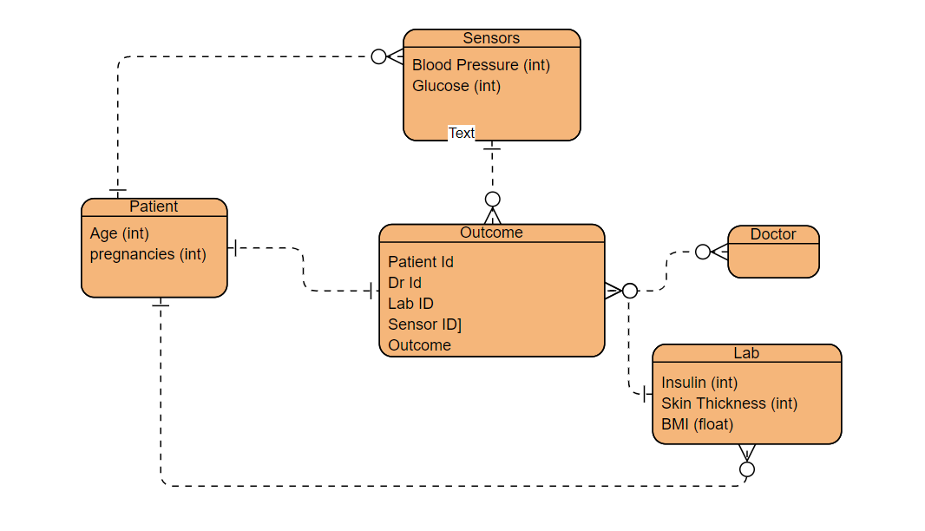
Modeling
Representation of domain models
Notes:
The first step in building out a domain model is thinking about what entities (or objects, or models are used) and the relationship between them. exist in the domain.
Data modeling is a set of tools and techniques used to understand and analyse how an organisation should collect, update, and store data.

Slide 6
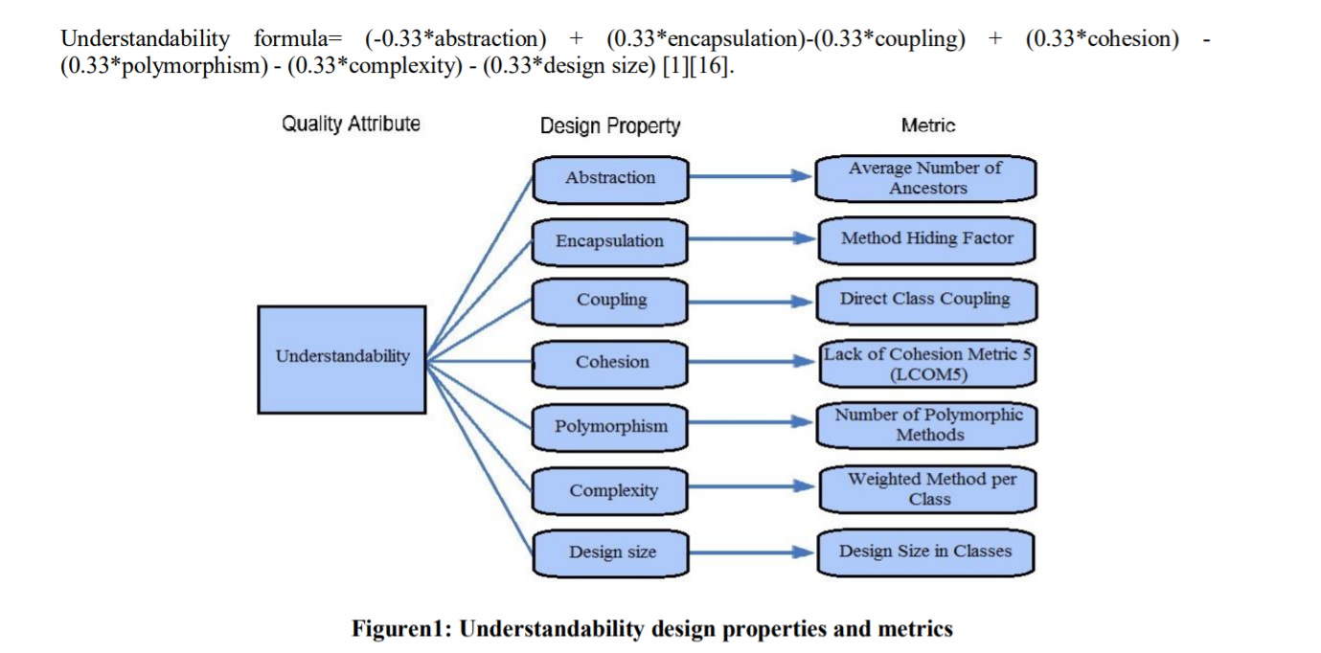
Evaluation
Transparency, Understandability
Notes:
Model evaluation aims to estimate the generalization accuracy of a model on future (unseen/out-of-sample) data
Evaluation is defined as the systematic study of a research artifact (here: modeling
methods) to determine its usefulness, effect, or impact [31]. IS Evaluation methods in
the area of conceptual information modeling can be classified in empirical and non-
empirical approaches and further distinguished as illustrated in Table 1.
Table 1. Overview of model evaluation methods (adapted and modified from [32])
Non-empirical evaluation methods Empirical evaluation methods
Feature comparison:
Modeling methods are compared by
modeling the same domain with different
methods and investigate how the various
methods represent the same problem,
based on a checklist of features (e.g.
[33]).
Survey:
This technique refers to the use of
questionnaires to gather human atti-
tudes, opinions, and impressions on
modeling methods (e.g. [34]).
Meta modeling:
This technique uses meta models of
methods as an analysis basis. It is at-
tempted to evaluate methods by structur-
ally investigating analogies and dissimi-
larities of their meta models (e.g. [35]).
Laboratory experiment:
In a laboratory experiment, independ-
ent variables, such as different model-
ing methods, are manipulated in order
to measure the effect on dependent
variables like accuracy or time costs
of modeling (e.g. [36]).
Metrics approach:
This technique aims at comparing meth-
ods based on a predefined set of method
metrics. Metric values are compared to
reference values which address complex-
ity and appropriateness of a method (e.g.
[37]).
Field experiment:
Researchers perform the investigation
in concrete business organizations
while trying to maintain control over
the most significant independent vari-
ables. Examples in the field of IS
modeling were not identified.
Paradigmatic analysis:
This technique refers to the analysis of Case study:
This technique focuses the systematic
underlying assumptions of methods,
e. g., the view of IS development inten-
tion, the view on language functions, the
definition of IS etc. (e.g. [21]).
observation of a particular group or
subject that utilizes the investigated
modeling method. The investigation is
conducted without intervening (e.g.
[38]).

Slide 7
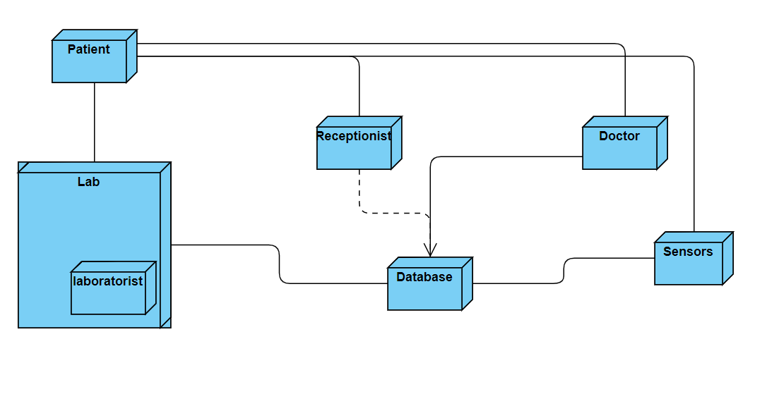
Deployment
Documentation
The deployment documentation might include training materials for new users and test plans to verify a successful deployment that can be reused when updating the software after the initial deployment.
Notes:
Deployment of machine learning models, or simply, putting models into production, means making your models available to your other business systems

Slide 8
Thanks

